Slide 1



Slide 2
Illinois Board of Higher Education
Student Advisory Committee
2025 Updates & Recommendations
Chair Prudence Barajas-Rodriguez & Vice-Chair Penny Bordewick | 03/12/2025

Slide 3

Introduction
The Student Advisory Committee (SAC) has had the honor of serving as a platform for students across the state to voice their ideas and provide feedback regarding higher education policies and initiatives.
Through collaboration with IBHE, the SAC works to ensure that the diverse needs of Illinois' student population are heard and addressed. We hope to collaborate with the Board in a communal effort of fostering an inclusive, responsive, and forward-thinking higher education system.
We have identified three main areas of interest that we would like to advise upon.

Slide 4
Identified Areas of Interest
Student Basic Needs – Housing Insecurity and Food Insecurity, Childcare, and Health Care.
College Affordability & Open Resource Educational Resources (OER)
Equity Initiatives, Mental Health Support, and Ongoing Efforts of the IBHE

Slide 5
Area One: Basic Needs
SAC has identified student basic needs as a point of interest to address in order to provide Illinois higher education students with the support they need to thrive in Illinois.
Housing security, food security, childcare, and health care are all pivotal factors to ensuring that Illinois students in higher education can attend their courses, complete their work, and ultimately help shape a better future.
From August 2022 to June 2023, 443 homeless students were reported by 35 institutions of higher education” (IBHE “Students Experiencing Homeless and Youth in Care Annual Report” April 2024).
“Forty-eight percent of college students report experiencing food insecurity and 22% report having to skip meals, per a recent national survey.” (Chicago Coalition to End Homelessness).

Slide 6
Identification of Basic Needs as an Area of Interest
Cross-institutional dialogue through the IBHE-SAC has brought concerns surrounding student basic needs to our attention that cross county lines, impacting nearly all Illinois students.
Brainstorming sessions revealed collective interest in localizing efforts to improve higher education in Illinois in the form of addressing student basic needs.
Following our second committee of the whole meeting we compared the interest in specific areas (i.e., housing security, food security, childcare services, and health care services) to A Thriving Illinois, IBHE's Strategic Plan.
As such, we adopted the term "student basic needs" to refer to such services and resources.

Slide 7
Proposed Recommendations of the IBHE SAC: Basic Needs
We encourage the Board to continue investing in and implementing ongoing learning and evidence-based support initiatives to localize and direct resources where needed to best support our communities.
We implore the Board to endorse and support institution-level review and reform of existing policies and procedures that further exacerbate equity gaps in higher education.

Slide 8
Acknowledgement of Ongoing Efforts & Relevancy of A Thriving Illinois
According to A Thriving Illinois, IBHE already aims to:
Establish and implement institution-level equity plans.
Provide equitable funding so students can receive the resources they need to succeed at any institution in the state.
SAC recommendations align with existing goals outlined in A Thriving Illinois; our recommendations are as follows:
Encourage institutional review and revisal of current policies and practices that may contribute to equity gaps.
Continue providing evidence-based support for institutions.

Slide 9
Area Two: College Affordability
College affordability presents a critical barrier to students pursuing an education.
The rising costs of tuition, fees, materials (i.e., textbooks, technology) creates significant financial burden for students, impacting their ability to thrive and/or continue to pursue an education.
Strategically coordinating resources to help alleviate the financial burden of cost-incurring factors such as textbooks and tuition costs will help improve access to higher education in Illinois.

Slide 10
Identification of College Affordability as an Area of Interest
The SAC’s is committed to improving access to higher education through improving foundational support for the student condition.
Through discussion financial stress emerged as central theme influencing student success and well-being.
It is pivotal to preserve the mobility that education grants in an equitable context so that every student can partake in higher education, regardless of socioeconomic status.

Slide 11
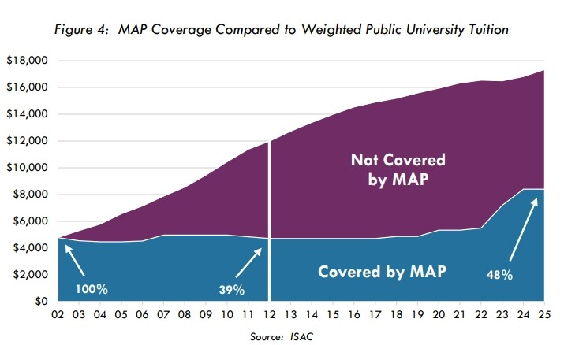
Area Two: College Affordability – MAP Grant Funding
In January for FY26, the board voted to recommend a $50 million in MAP funding; which would bring the total appropriation to $761.6 million.
MAP currently covers 48.4% of the average tuition and fees at public universities.

Slide 12
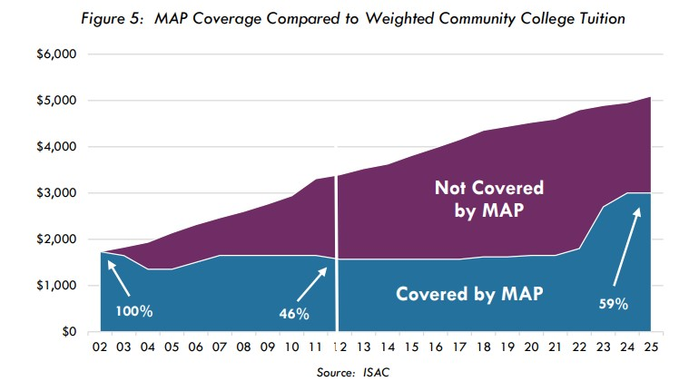
Area Two: College Affordability – MAP Grant Funding
In January for FY26, the board voted to recommend a $50 million in MAP funding; which would bring the total appropriation to $761.6 million.
MAP currently covers 58.9% of the average tuition and fees at community colleges.

Slide 13
Area Two: College Affordability – Open Educational Resources (OERs)
Open educational resources are free teaching and learning materials that anyone can use, reuse, and adapt.
Faculty use of OERs can lead to an average savings of $300 per student, per semester at some colleges (Idzik, 2025).
OER use is tied to higher grades, retention, course completion, and positive student perceptions (Colvard, Watson, & Park, 2023).
Faculty and administration at various institutions (such as Harold Washington College, NEIU, and John A. Logan College) have begun to advocate for and make the switch to OER. Additional support from IBHE would be powerful and impactful.

Slide 14
Proposed Recommendations of the IBHE SAC: College Affordability
The SAC acknowledges and encourages the continued support of MAP funding towards the goal of $1B in funding provided to students. MAP offers critical assistance to students throughout the state, helping to ensure access to higher education with the fiscal support necessary to do so.
The SAC encourages IBHE to support colleges and universities in Illinois in a movement towards the implementation and utilization of open educational resources (OERs) throughout disciplines.

Slide 15
Acknowledgement of Ongoing Efforts & Relevancy of A Thriving Illinois
According to A Thriving Illinois, IBHE already aims to reach a goal of $1B in MAP grant funding.
A Thriving Illinois outlines a goal to pilot and expand shared services to reduce institutional administrative costs.
A Thriving Illinois outlines a goal to further encourage joint purchasing agreements among institutions.
Our recommendations align with the themes and goals outlined in A Thriving Illinois.
We commend and encourage the continued support for additional MAP grant funding.
We implore IBHE to support a movement toward the use of OERs in Illinois HEIs as opposed to paid textbooks.

Slide 16
Area Three: Equity, Mental Health support & IBHE’s Ongoing Efforts
The CDC and the APA have long since acknowledged that there is a widespread, ongoing mental health crisis in the United States.
As such, there is a high demand for mental health services for students in Illinois.
Suicide is the second leading cause of death for college-aged individuals in the United States (Xiao et al., 2021).
Equity, mental health services, and support resources directly impact the ability of Illinois students and their communities to succeed and thrive.
The SAC prioritizes these characteristics to foster an education system that provides students with tools to reach their full potential.

Slide 17
Identification of Equity, Mental Health support & IBHE’s Ongoing Efforts
During SAC discussions, we found an increasing need for mental health and support services across Illinois institutions.
Most members were able to provide a personal anecdote on how mental health services are needed as a result of crisis or tragedy within their communities.
To foster an environment in higher education where students can reach their full potential, we must meet student needs holistically.
Safety, security, and well-being are paramount.

Slide 18
IBHE-SAC Proposed Recommendations: Equity, Mental Health Support, & IBHE’s Ongoing Efforts
Continue initiatives that help to develop of institution-level programs to increase support for mental health and wellness services.
Continue to push for the implementation of equity plans at an institution level.
Explore initiatives to diversify faculty & staff voices as well as curricula, at an institution level.

Slide 19
Acknowledgement of Ongoing Efforts & Relevancy of A Thriving Illinois
According to A Thriving Illinois, IBHE aims to:
Design professional development programs to achieve equity through training in cultural humility, trauma-informed lens training, and emphasizing intersectionality.
Call for continued support of basic student needs, including mental health/wellness services.
Our recommendations are to continue efforts in investing, expanding, and exploring avenues to improve student support and wellness services such as mental health services.

